Slide 1
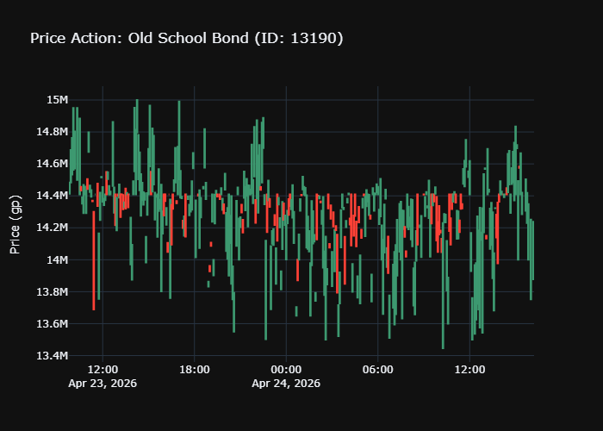
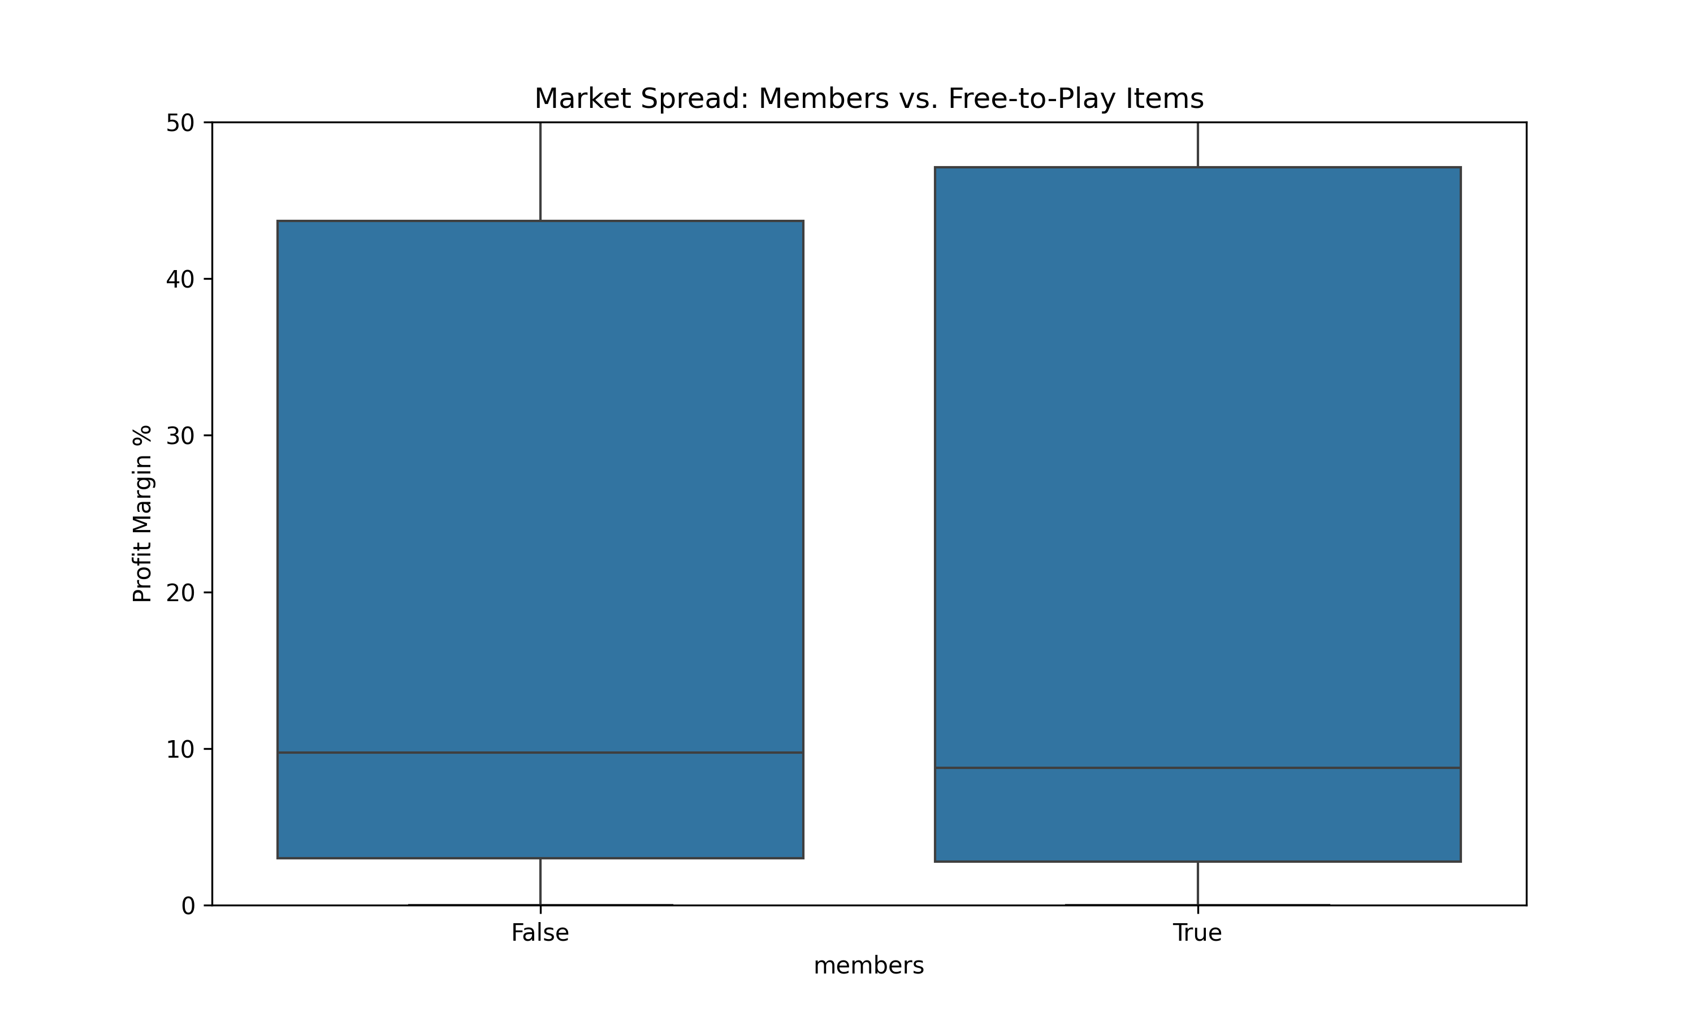
Algorithmic Market Analysis: Volatility and Correlation in a Gaming Economy
Modern virtual economies provide a unique playground for data mining and predictive analysis. This study explores the Old School RuneScape (OSRS) market using real-time price and volume data fetched via the OSRS Wiki API. The research focuses on three key pillars:
Market Volatility: Identifying high-margin "flipping" opportunities.
Economic Correlation: Measuring the statistical link between raw and processed assets.
Optimal Timing: Mapping global trading volume to UTC timeframes. Using automated data collection and statistical modeling, this project demonstrates how algorithmic analysis can optimize trading strategies in a decentralized digital market.
Market Efficiency (Quantile Analysis): * F2P Markets: Exhibit "perfect competition" with margins heavily concentrated in the 0–2% range, offering limited profit potential.
Members Markets: Demonstrate higher volatility with margin outliers reaching 10–25%, identifying the optimal sector for web-mining and flipping strategies.
Liquidity & Price Action (Candlestick Analysis):
High-Volume Stability: Assets like the Old School Bond show smooth price action, allowing for high-liquidity entry and exit with lower risk.
Low-Volume Risk: Niche items (e.g., 3rd Age Amulet) exhibit price "gaps" and significant wicks, indicating high-risk/high-reward territory where single trades shift market value.
Final Summary: The Grand Exchange is macro-efficient but micro-volatile. By combining Quantile grouping to select the asset class and Candlestick analysis to time the trade, a data-driven participant can consistently outperform the average market baseline.
This research utilized the OSRS Wiki Real-Time Prices API to gather high-fidelity market data. A custom Python pipeline was developed to automate the collection of item metadata and pricing at 5-minute intervals. Data was processed using the Pandas library to calculate volatility margins and merged with historical time-series data to perform correlation analysis. All datasets were serialized using Pickle to maintain data integrity and support time zone-aware (UTC) analysis for global trading trends.
The Top left graph is a candle stick graph of the auction sales
Bottom right is the marge price difference with nonmember's and members
Dr. Charles Hoot
https://github.com/hbindel26/Final-project-web-mining.git
https://runescape.wiki/w/Application_programming_interface

Slide 2
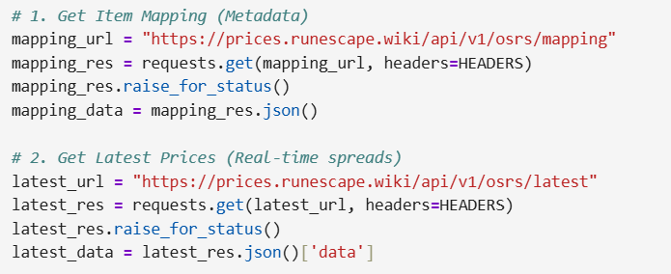
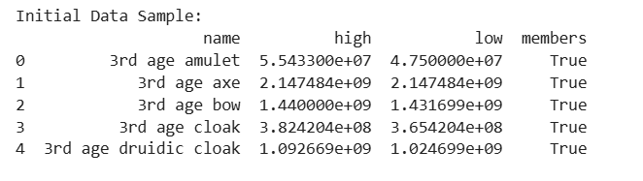
raw Data
1. Primary Source & Methodology
OSRS Wiki API Integration: Leveraged high-frequency Real-Time Prices and Metadata Mapping APIs.
Responsible Mining: Implemented a custom User-Agent string (Contact: Discord/Email) to adhere to the Wiki’s Fair Use policy, preventing IP blocks and ensuring transparent data scraping.
Tooling: Utilized the Python requests library to ingest JSON payloads of "insta-buy" and "insta-sell" price points.
2. Serialization & Caching (The .pkl Workflow)
Storage Protocol: Employed the pickle library for high-speed data serialization (ge_data_cache.pkl).
Technical Rationale: Unlike CSVs, Pickle preserves native Python object structures and timezone-aware UTC timestamps, which are vital for accurate 5-minute interval time-series analysis.
Efficiency: Caching local data snapshots minimizes redundant API calls, reducing network overhead while maintaining a consistent "truth" for analysis.

Slide 3
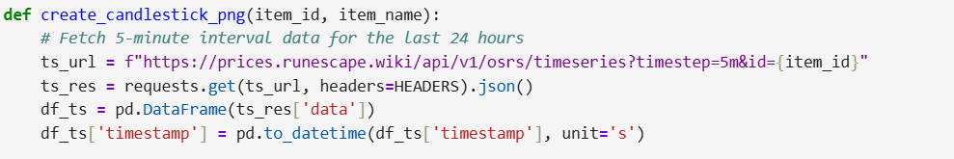
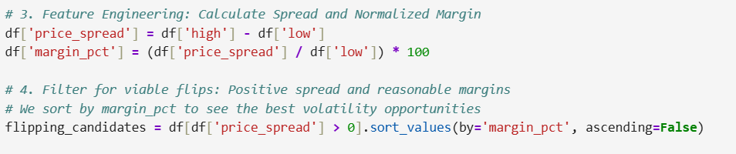
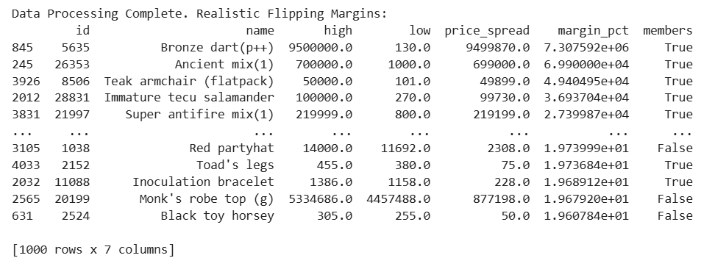
USING THE DATA
. Data Engineering (The Pandas Pipeline)
Relational Merging: Performed a join between Item IDs, Names, and Members-status to contextualize raw price values.
Noise Reduction: Filtered out "dead" items with zero trading volume. This ensures the data represents an active, tradeable market rather than theoretical values.
2. Feature Engineering for Analysis
To move from raw numbers to market strategy, we calculated:
Absolute Spread: $High - Low$ (Gross profit potential per unit).
Margin Percentage: (Normalized profitability across different price brackets).
3. Practical Application: "Using the Data"
Market Distribution: Using the processed data to distinguish between the "efficient" F2P market and the "volatile" Members market.
Price Action Analysis: Utilizing the cleaned dataset to generate Candlestick charts and Quantile plots, allowing a data-driven trader to identify specific entry and exit windows based on liquidity.
t

Slide 4
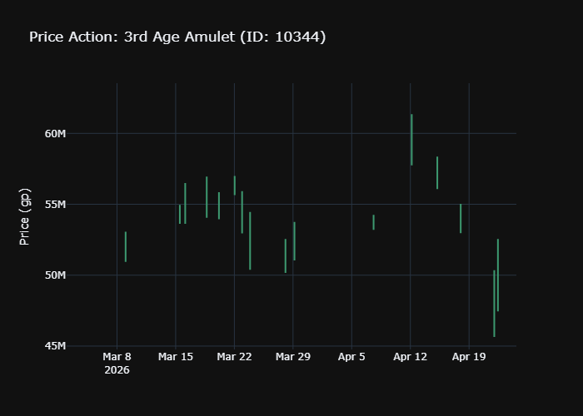
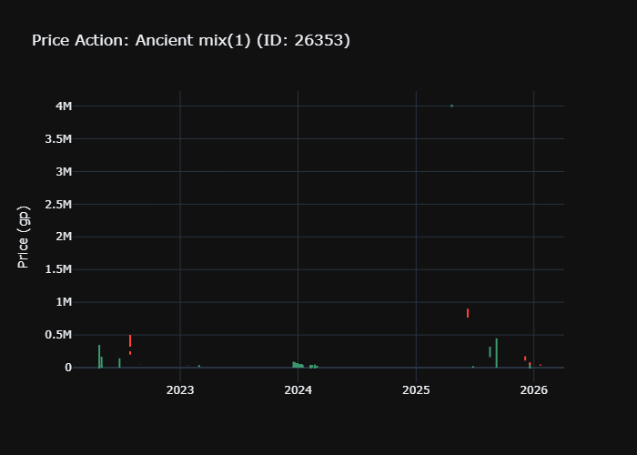
GRAPHS!!!
t

